Slide 1
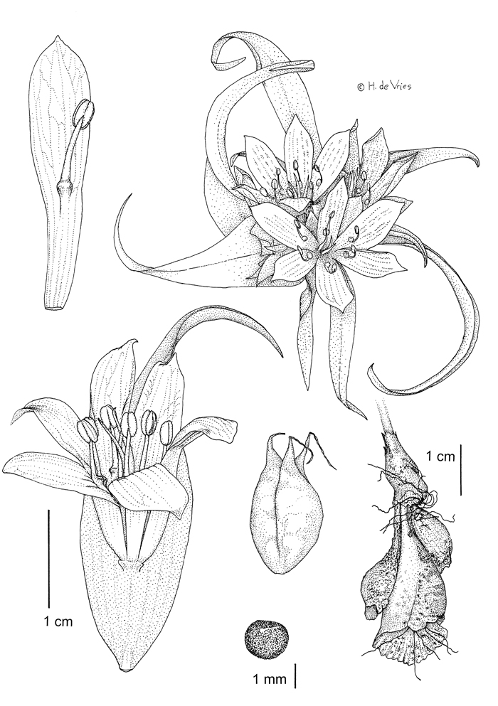
The Botanical Artist
An Integrated Lesson Plan emphasizing observation
Donna Pence

Slide 2
What is a Botanical Drawing?
Botanical illustration is the art of depicting the form, colour, and details of plant species, frequently in watercolour paintings. These are often printed with a botanical description in book, magazines, and other media. The creation of these requires an understanding of plant anatomy, access to specimens and references, and are often composed in consultation with a scientific author.

Slide 3
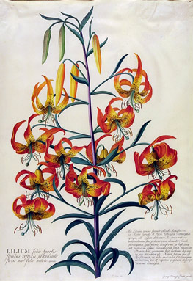
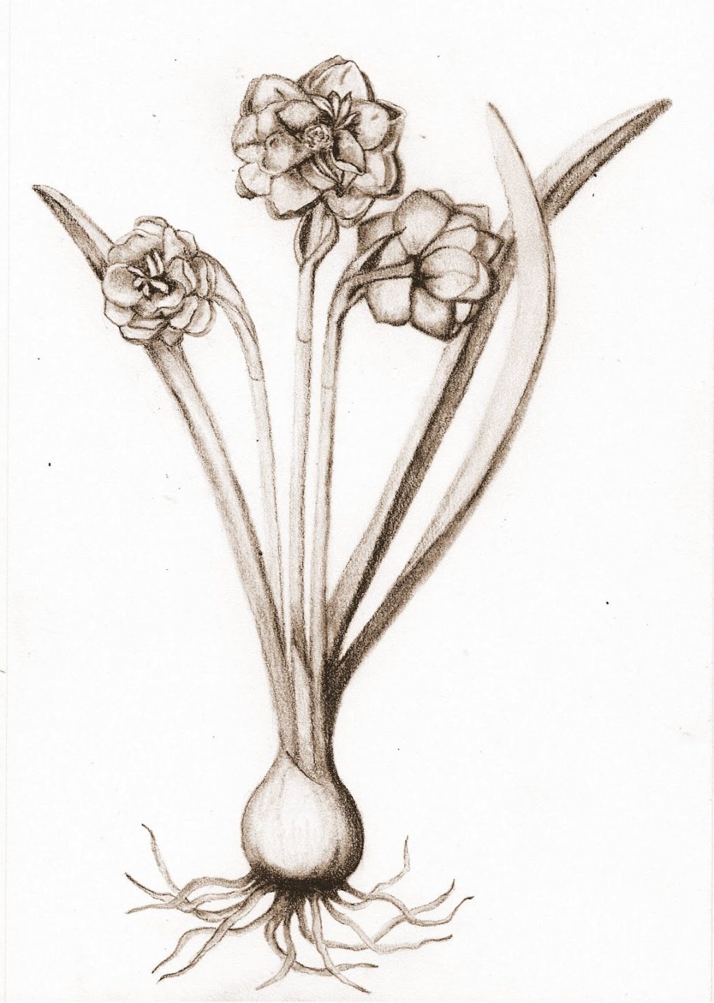

Slide 4
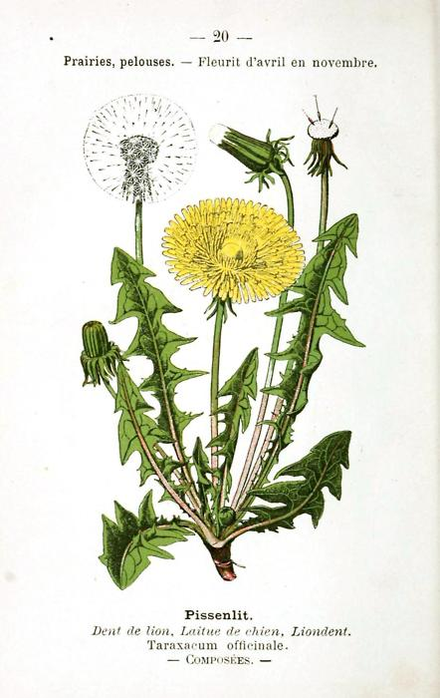
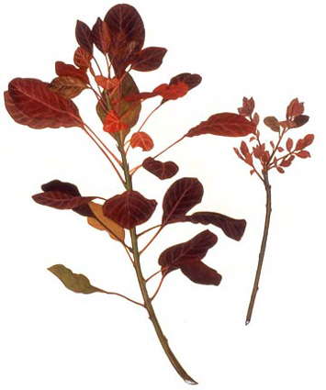

Slide 5
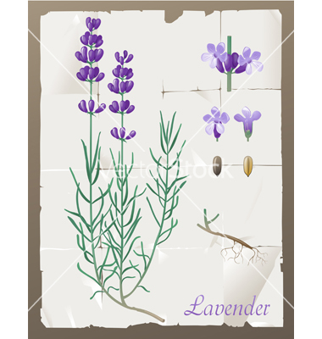
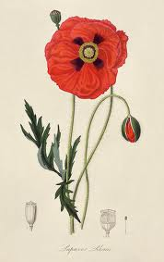
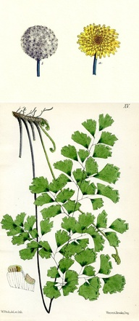

Slide 6
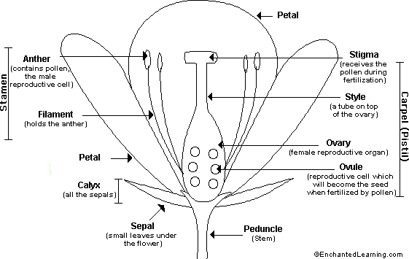
The Flower:
The flower is the reproductive unit of some plants (angiosperms). Parts of the flower include petals, sepals, one or more carpels (the female reproductive organs), and stamens (the male reproductive organs).

Slide 7
The pistil is the collective term for the carpel(s). Each carpel includes an ovary (where the ovules are produced; ovules are the female reproductive cells, the eggs), a style (a tube on top of the ovary), and a stigma (which receives the pollen during fertilization).
Stamens are the male reproductive parts of flowers. A stamen consists of an anther (which produces pollen) and a filament. The pollen consists of the male reproductive cells; they fertilize ovules.
Fertilization:
Pollen must fertilize an ovule to produce a viable seed. This process is called pollination, and is often aided by animals like bees, which fly from flower to flower collecting sweet nectar. As they visit flowers, they spread pollen around, depositing it on some stigmas. After a male's pollen grains have landed on the stigma during fertilization, pollen tubes develop within the style, burrowing down to the ovary, where the sperm fertilizes an ovum (an egg cell), in the ovule. After fertilization, the ovule develops into a seed in the ovary.
Types of Flowers:
Some flowers (called perfect flowers) have both male and female reproductive organs; some flowers (called imperfect flowers) have only male reproductive organs or only female reproductive organs. Some plants have both male and female flowers, while other have males on one plant and females on another. Complete flowers have stamens, a pistil, petals, and sepals. Incomplete flowers lack one of these parts.

Slide 8
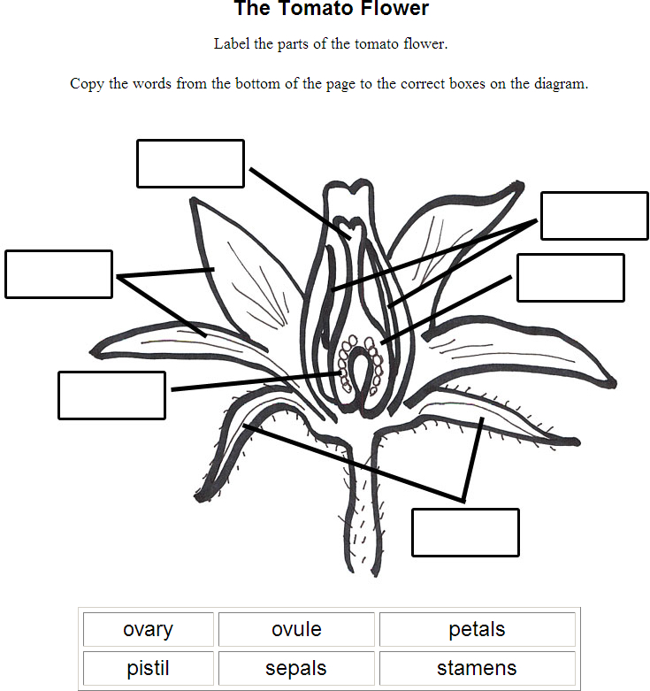

Slide 9
For Teachers
Botanical Drawing encourages creative perspectives about objects that are part of the student’s every day lives and helps them develop an appreciation for their natural environment. Children like the colors, fragrances, and flavors of flowers, fruits, and vegetables, which adds to their enjoyment of the process.

Slide 10
Designing the lesson
Younger students (8-11years) need several shorter working periods and prefer to tackle a variety of subjects in order to keep focused
It is also important to explain what will be covered in the class and what they are expected to do with their supplies and materials. Giving them an allotted time for setting up and cleaning up creates a structured atmosphere

Slide 11
Teaching Children to “See”
past experiences in drawing often involved stereotyping objects using preconceived images.
see the object from a new perspective. Examples include looking at a flower from the back where the stem attaches or looking up from underneath the flower.
Viewfinders can be made easily from paper with a square or rectangle cut out of the center. Students can then use this aid to visually crop the subject, and this helps them to see shapes within or around the object.

Slide 12
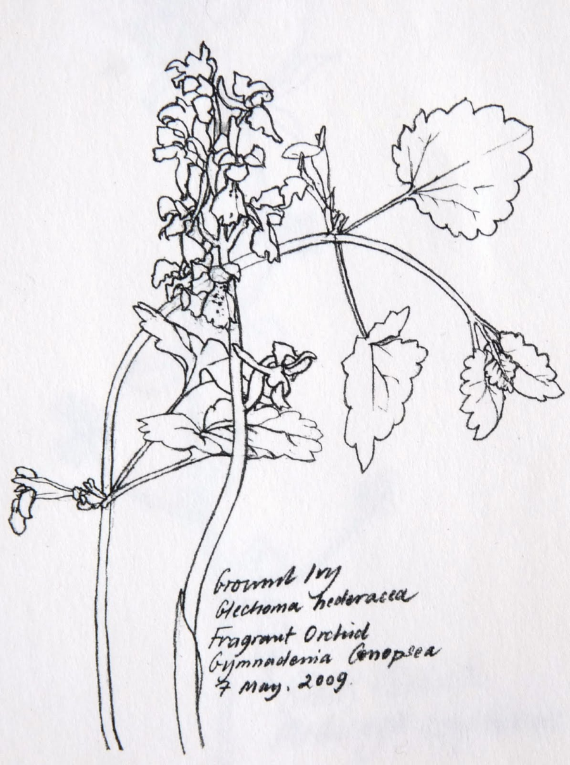
Contour Line Drawing
keeping their eyes on the outline and the contours of the object with minimal looking at their paper. This helps them focus on the reality of what they see versus what they think they see.

Slide 13
Materials
Quality paper (preferably watercolor)
#2 Pencil
Kneaded eraser
Watercolors
Fine tip permanent marker (calligraphy pen)
Brushes
Still life setup and subject to draw
viewfinder

Slide 14
Where to Draw
Avoid Plein Air (working outdoors) Bringing the subjects into the classroom allows the children to work “up close and personal” with their subject, and they are much happier with the results.
Providing a backdrop for their subject, such as a folded piece of white cardboard, helps eliminate many surrounding distractions and improves concentration.
Encouraging students to arrange the subject in a way that suits them also involves them more in the creative process. Providing floral oasis for positioning their flowers or assisting their efforts to slice through a fruit or vegetable for a view that interests them adds to the inspiration necessary for the work to succeed.

Slide 15
Reflection
Encourage Students, to hang their drawings or paintings on a wall. This allows them to see the variety of ways that the subjects have been addressed and is a valuable educational tool.
Letting each student share what they believe to be their greatest challenge or success helps every one clarify their goals and further their understanding of the various ways to get there.

Slide 16
The Picture Plane
http://www.asba-art.org/article/education-forum-perspective-part-1

