Slide 1
Shape Monsters
Kindergarten Pre-Assessment to evaluate basic manual dexterity,
cutting, gluing, following directions.

Slide 2
How Does a Line Become a Shape?
Make a shape from a line

Slide 3
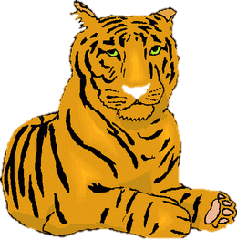
A Horizon Line is where our eye sees the sky touch the ground. Can you trace it?
Where should the animals go? Which is near and which is far?

Slide 4
Draw a Horizon Line on your Paper.
Using an oil pastel, draw a horizon. It can be straight, curvy, zigzag, or diagonal. What happens when we change the horizon line?

Slide 5
Let’s Paint Our Background!
Be gentle with your brushes, don’t scrub!
Don’t mix your paint colors in the cakes.
Don’t use black!
Wash your brush, but don’t leave it in the water.
Write your name on the back of your paper
With your brush, put a puddle of water in the lid of your watercolor set.
Now paint your sky only with water
Now pick a color for your sky, and add plenty of that color to your puddle.
Starting at your horizon line, paint back and forth to the top of your paper using the paint from your puddle.
Clean your brush, and lid and start over for the ground.

Slide 6
Resources
Printable book

