Slide 1
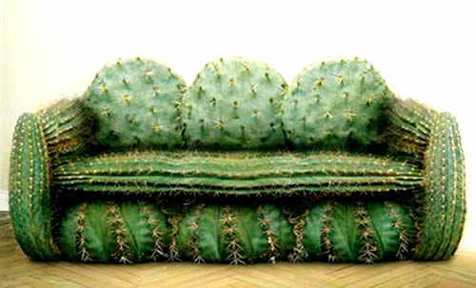
Crazy Cactus Georgia O’Keefe and the Elements of Art

Slide 2
The Prickly Pear Cactus
The Prickly Pear Cactus is found throughout this region. The prickly pear is the official state plant. It is green in color. Its “pads” are actually branches and its needle like thorns are “leaves.” It does bloom with either yellow, red, or purple flowers; and produces a fruit. The pads have been cooked and eaten as a vegetable for hundreds of years in Mexico! The fruit is cooked and eaten too!

Slide 3
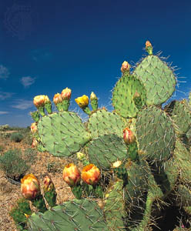
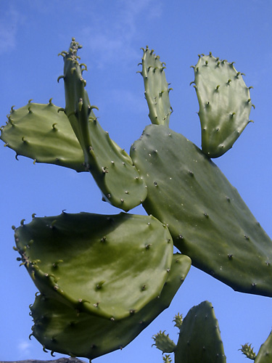
Notice how the shapes of the branches change depending on the angle that you see them.
Have you ever seen a cactus up close before? Have you felt it?

Slide 4
Yellow Cactus, by Georgia O’Keefe

Slide 5
Georgia O’Keefe
Meet The Artist:
• O’Keeffe was born in 1887 on a Wisconsin farm, she was the second of seven children. (She was born about the same time the telephone and light bulb were invented.)
• Her parents believed in the education of women so, O’Keeffe and her sisters were given art lessons which were uncommon for girls at that time.
• By age 13, she was very independent and knew she wanted to be an artist. She had a strong personality, liked to be different and rebelled against being like anybody else.
• As a young woman, she moved first to Chicago and then to New York to study art. While in New York, she met photographer and gallery owner by the name of Alfred Stieglitz. They were married in 1924 and he encouraged her to paint fulltime.
• O’Keeffe’s work from this period included many oversized paintings of flowers. She once said that since we often ignore them in life, she decided to make her flowers too large to be ignored.
• In these early paintings, she reduced nature to its simplest, abstract form by using a very close-up view.

Slide 6
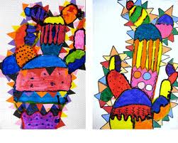
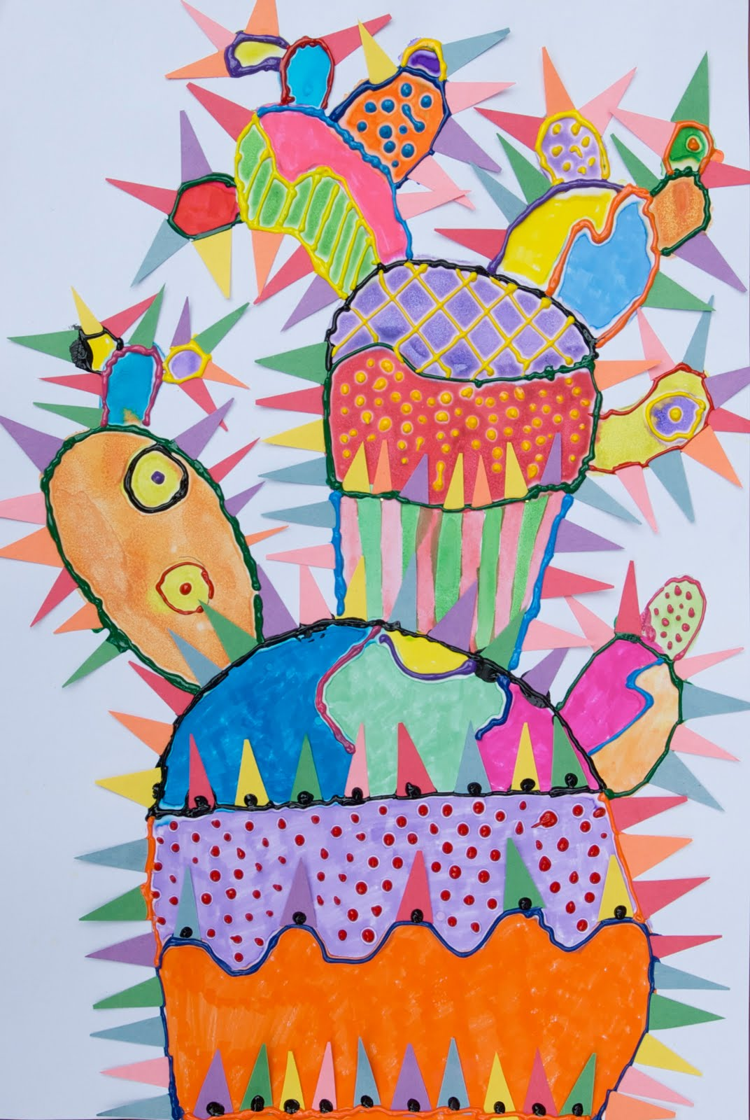
Crazy Cactus
When a single line bends to touch itself or another line, a shape is created. Repetition of bending lines that connect and build upon each other in a progression from large to small creates a visual rhythm, like the rhythm in music.

Slide 7
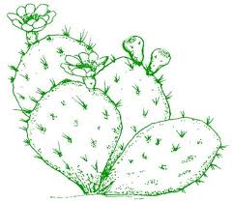
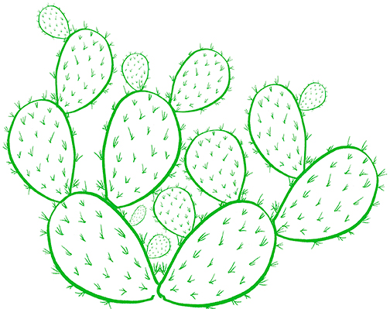
1. Draw a Cactus.
On a 12x18 sheet of white paper draw curving lines in various sizes and shapes that connect and stack on top of each other. Start with the biggest shape at the bottom and progress upward. Work the way up adding a few here and there making sure they connect and overlap .
Big shapes using the whole page.
Divide the big shapes in halves
and into thirds with straight or
curving lines

Slide 8
2. Color and/or Paint Cactus
Fill in the drawing with imaginative colors and designs using markers and watercolor paints.
As you are texturizing your cactus think…Zig and zaggy lines, striped easter eggs, yellow and orange googly eyes, Purple with polka dots.

Slide 9
3. Make Cactus Needles (leaves)
Cut three or four sheets at a time of the colored paper into strips that are about one inch wide. Then cut these strips into triangle shapes by making diagonal cross cuts.
Save them in an envelope for later

Slide 10
4. Add Squeeze Paint and Paper Needles
Cover the tip of the bottle with your finger, shake the bottles and gently squeeze to test paint on a separate sheet of paper first.
Then rest the nozzle on the drawing surface and outline the cactus, a sections at a time.
Poke the paper needles into each wet section of paint. It will harden and hold them in place.
Work from top to bottom, away from the wet areas to avoid smearing fresh paint

Slide 11
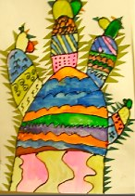
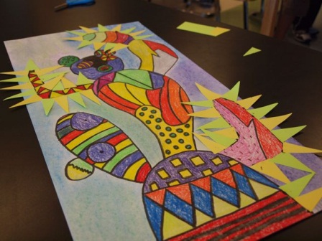
What do you like about these?

