Slide 1
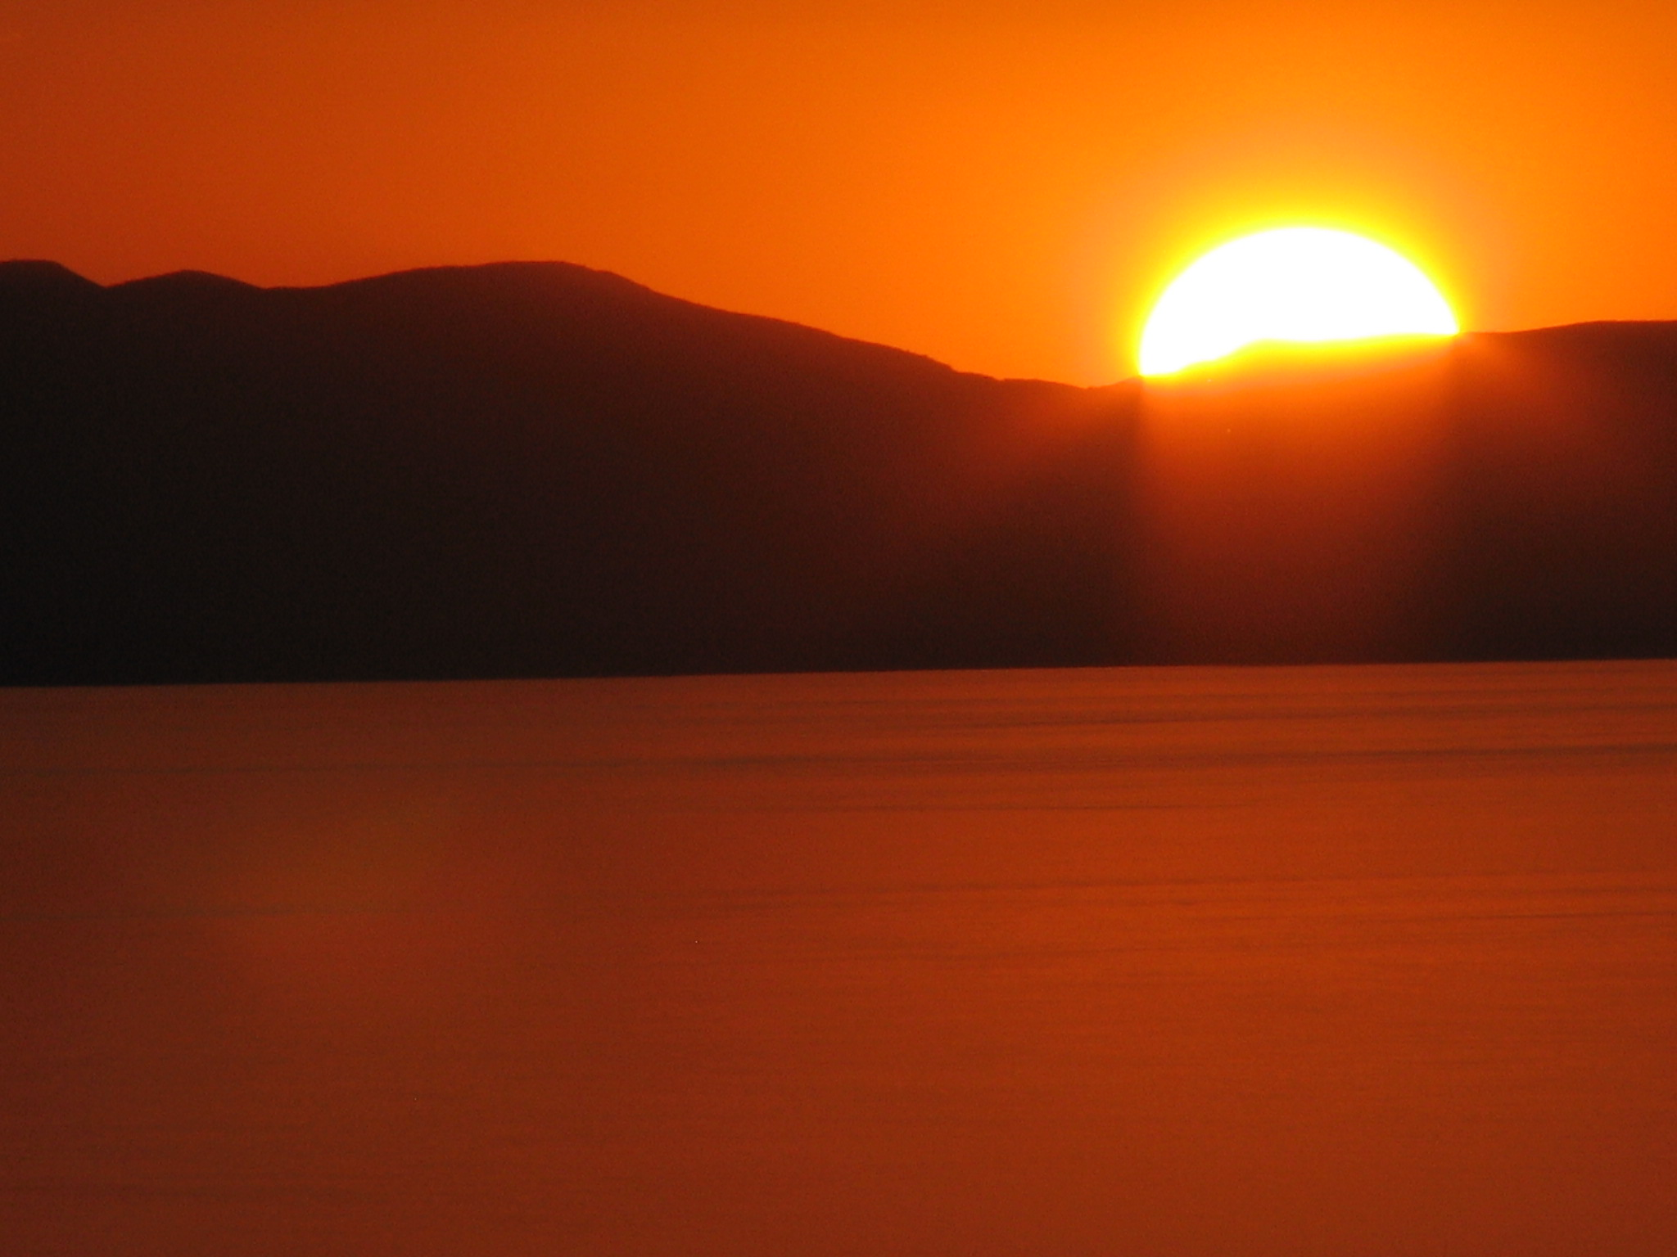
Color and Light Waves
How is it that I am able to see that?
Notes:
What enables us to see the light and experience such wonderful shades of color during the course of our everyday lives? Some may take seeing for granted, but if the process is looked at closely, you can see what a wonder it really is

Slide 2
the visible spectrum is often times remembered as ROY G. BIV: red, orange, yellow, green, blue, indigo, and violet.

Slide 3
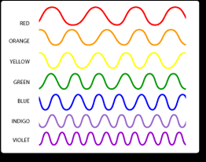
Light travels in the form of a wave.
White light, or the light from the sun, is made of colors, and colors are different types of light recognized by their own wavelengths

Slide 4
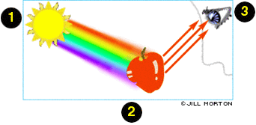
Light waves can be reflected, absorbed, or transmitted, depending on the object that the wave hits
light is necessary if we are to have any perception of color at all. An object is "colored," because of the light it reflects—all other colors are absorbed into that specific object

Slide 5
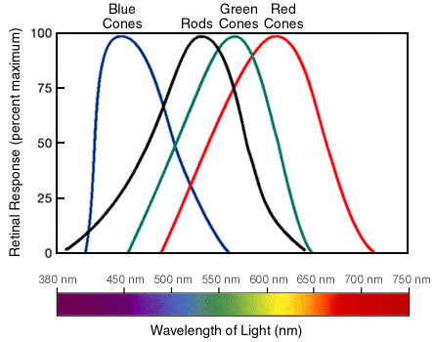
We are capable of seeing color because our eyes have light and color-sensitive receptors.
These receptors are called rods (receptive to amounts of light) and cones (sensitive to colors)

Slide 6
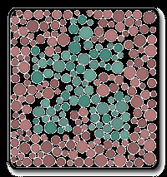
Color Blindness and
9% of the population has some type of colorblindness, with Men being more than twice as likely.

Slide 7
Can Animals See Color?
ANIMAL | THE COLORS THEY SEE
SPIDERS (jumping spiders) | ULTRAVIOLET AND GREEN
INSECTS (bees) | ULTRAVIOLET, BLUE, YELLOW
CRUSTACEANS (crayfish) | BLUE AND RED
CEPHALOPODS (octopi and squids) | BLUE ONLY
FISH | MOST SEE JUST TWO COLORS
AMPHIBIANS (frogs) | MOST SEE SOME COLOR
REPTILES (snakes) | SOME COLOR AND INFRARED
BIRDS | FIVE TO SEVEN COLORS
MAMMALS (cats) | TWO COLORS BUT WEAKLY
MAMMALS (dogs) | TWO COLORS BUT WEAKLY
MAMMALS (rabbit) | BLUE AND GREEN
MAMMALS (squirrel) | BLUES AND YELLOWS
MAMMALS (primates-apes and chimps) | SAME AS HUMANS
MAMMALS (African monkeys) | SAME AS HUMANS
MAMMALS (South American monkeys) | CAN'T SEE RED WELL

Slide 8
What causes an afterimage?
Stare at this image for 30 seconds

Slide 9
Color Schemes Complimentary, Analogous, Monochromatic and Triadic

Slide 10
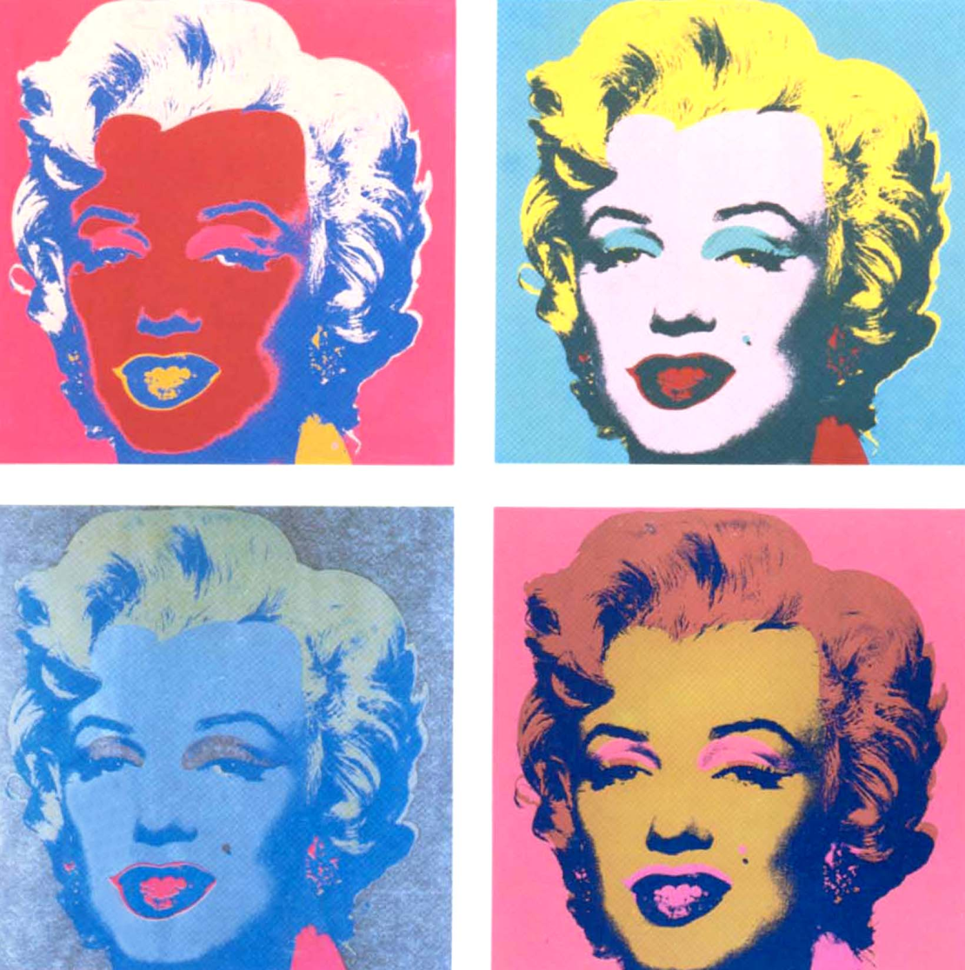
Pop Art and Color
Andy Warhol
In the 1960’s Andrew Warhol graduated in pictorial design from a technical college. He was fascinated with fame and the media.
This website explores Warhol’s motivations as a Pop Artist.

Slide 11
Equiluminance
When two colors placed next to each other are equally bright, their boundaries are hard for the eye to distinguish, making the image vibrate or twinkle. This is called “equiluminance”

Slide 12
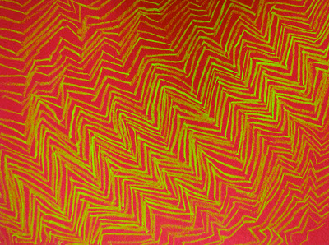
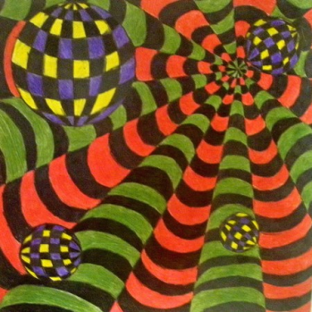
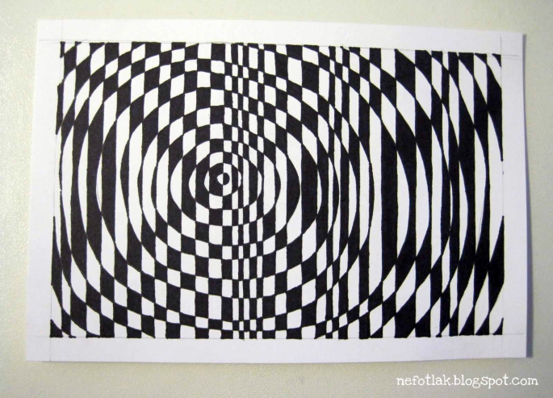
Op Art Lesson Plans
5th Grade Bridget Riley
6-8th Grade Victor Vasserely
Op Art with Black and White
4th grade hands
Younger grades Op art hand

Slide 13
