Slide 1
Chinese New Year
Lion Dance Costume

Slide 2
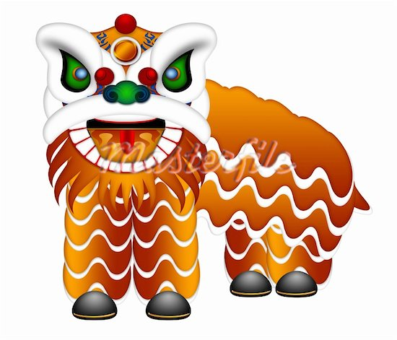
The Lion dance is meant to ward off evil spirits

Slide 3
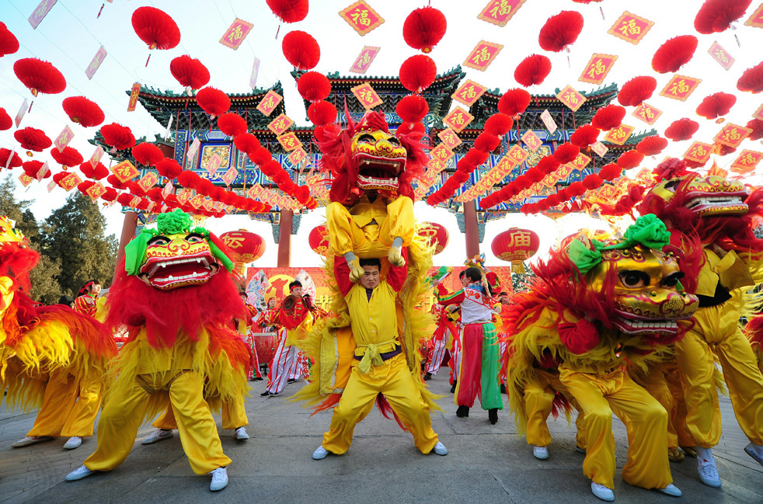
Often it is an athletic dance done by acrobats

Slide 4
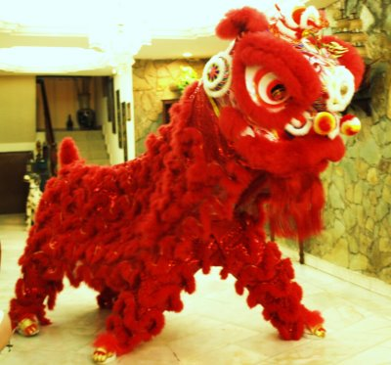
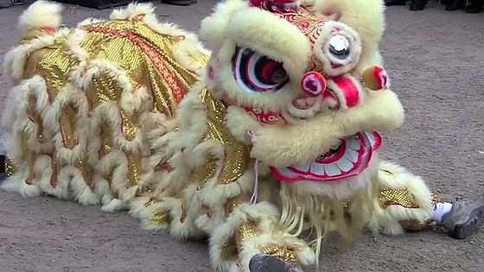
Unlike the Dragon dance, the lion dance is just two dancers

Slide 5
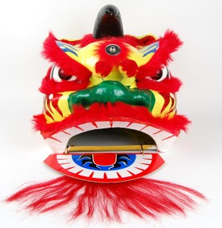
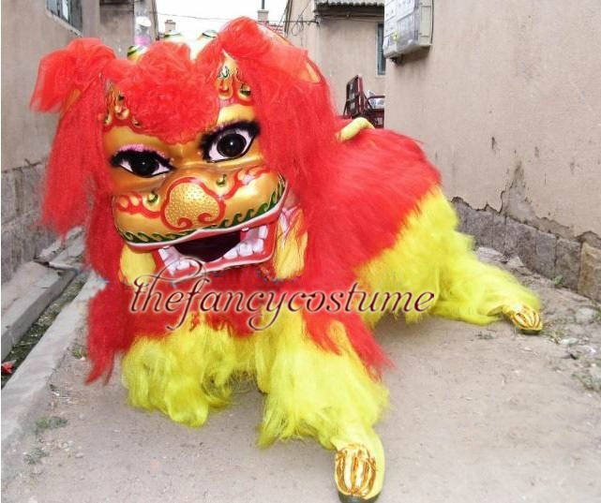
The head is traditionally yellow or red with painted patterns and applied materials

